Slide 1
Benchmarking Generation And Evaluation Capabilities Of Large Language Models For Instruction Controllable Summarization
Himanshuraj Kashyap – 202218006
Isha Motiyani - 202218015
Raj Shah – 202218029
Nidhi Somaiya – 202218060
Radhika Singhal - 202218062

Slide 2
Table of contents
01
02
03
04
Instruction Controllable Text Summary Generation
Human Annotation Collection
Dataset creation, System Output Evaluation, LLM’s good at Ins-Controllable Summarization?
Why and what tasks were performed?
Are LLMs good at Ins-Controllable Summary Evaluation?
Can We Automate Ins-Controllable
Summarization Benchmarking?
LLM based evaluation protocols, Evaluation settings LLM-based
GPT -4 coupled with LLMCompare for automatic evaluation benchmarking

Slide 3
01
Why are we studying instruction controllable text summary generation and its evaluation techniques?
What are the tasks performed?

Slide 4
WHY?
WHAT?
1. Overcoming Saturation in Summarization:
2. Incorporation of natural language instructions provides greater controllability and flexibility in the summarization process.
3. It tackles the limitations of generic summarization settings, which can be too simplistic and under constrained.
4. The approach aims to mimic actual reading experiences by considering diverse information needs along the reading.
5. Three identified dimensions—Informational, Formatting, and Meta—allow for a nuanced and comprehensive summarization approach.
Human Annotation Collection
Dataset Creation
System Output Evaluation
Are LLM’s good at Ins-Controllable Summarization
LLM-based Evaluation Protocols
Are LLMs Good at Ins-Controllable Summary Evaluation?

Slide 5
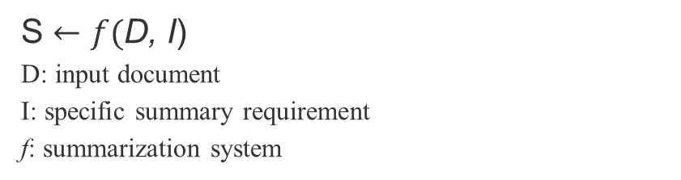
02
Human Annotation Collection
S $←f($D, I)
D: input document
I: specific summary requirement
f: summarization system

Slide 6
Dataset Creation
Data Source: XLSum (Hasan et al., 2021) English split, BBC news articles.
Pairs Collected: 100 article-requirement pairs.
Abundant and complex information.
Length: 1000-1200 words for human evaluation.
Mimic actual reading experience.
Three dimensions: Informational, Formatting, Meta.
GPT-4 used for diverse candidate requirements.
LLMs are prompted with a zero-shot prompt.
Article-requirement pairs used as input for summarization.
Each LLM generates an initial summary based on the provided input, and minimal necessary edits are made to the generated summary by human
Interchangeable use of LLMs: text-davinci-003, gpt-3.5-turbo-0301, gpt-4-0314.
Finding Challenging Articles
Summary requirements
Hybrid LLM-Human Summary:
Dataset:
Article: {……}
Summary requirement: {…..}
LLM generated summary: {….}
Hybrid summary :{….}

Slide 7
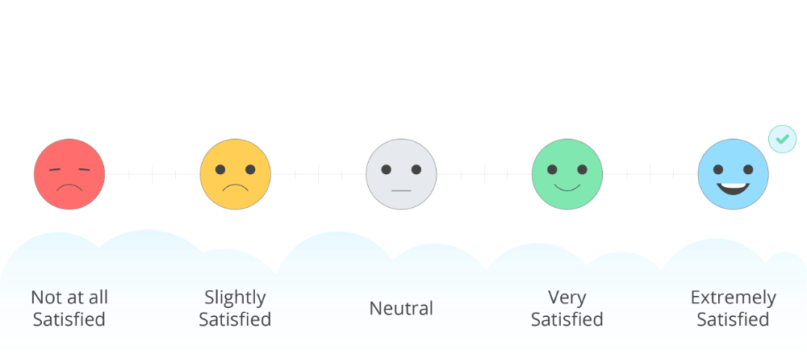
System Output Evaluation
INSTRUSUM benchmark with 500 human annotations.(100 samples for each model)
Quality Dimensions and Annotation Protocol
Annotation Process:
Annotators recruited on Amazon Mechanical Turk
Quality, Missing Information, and Irrelevant information range: score from 1(best) to 5(worst)
Factual score: The ratio of factually consistent summaries
Low factual consistency may stem from a sparsity of errors.
Therefore, hence it was manually verified
Likert scale
Overall Quality
Irrelevant Information
Krippendorff’s alpha:
Overall Quality: 0.2571
Missing Information: 0.2247
Irrelevant Information: 0.1925
Factuality: 0.0196
Missing Information
Factual Consistency
[provide a short explanation for the ranking ]
[Select the span of inconsistency and edit it if possible]

Slide 8

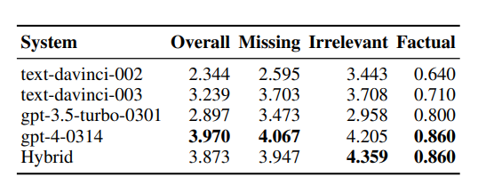
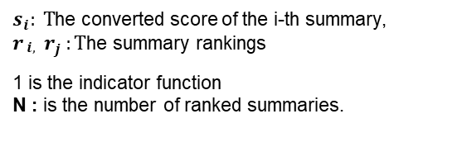
Are LLM’s good at Ins-Controllable Summarization
Converting human annotated ranking to score
$s_{i}: T$he converted score of the i-th summary,
$r_{\begin{aligned}i, \\ \end{aligned}}$ $r_{j }:T$he summary rankings
1 is the indicator function
N : is the number of ranked summaries.
1. There is a large performance gap among the different LLMs.
Significant performance difference, with GPT-4 outperforming GPT-3.5 models.
2. The hybrid LLM-human summary can only outperform GPT-4 on the irrelevant information aspect
It indicates that generating summaries without irrelevant information is the most challenging aspect for the current LLMs.
3. All LLMs we evaluated still make considerable factual errors in their summaries.

Slide 9
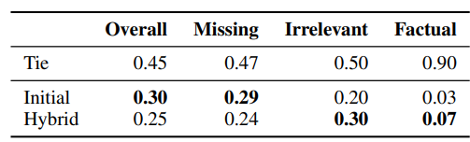
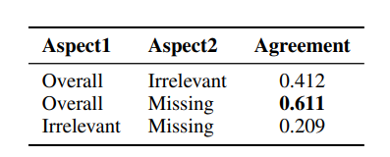
4. Fine-grained Analysis of the Hybrid LLMHuman Summary:
Hybrid summaries perform better in irrelevant information and factual consistency is worse in overall quality and missing information aspects.
4. Inter-Aspect Analysis:
The results show that the missing information aspect has a higher influence on the overall quality aspect than the irrelevant information aspect, suggesting that human annotators prefer more comprehensive summaries than more concise summaries

Slide 10
03
Are LLMs good at Ins-Controllable Summary Evaluation?

Slide 11





LLM-based Evaluation Protocols
LLMScore Protocol: Direct scoring using predicted probability. For. example, a prompt asks if a summary is good quality with the answer "Yes.“
LLMEval Protocol: LLM assigns a quality score from 1 to 5 using a format similar to the Likert scale.
LLMCompare Protocol: LLMs presented with two candidate outputs for comparison. Evaluation involves choosing between two summaries.
4. LLMRank Protocol: Listwise ranking by text completion. Simultaneously evaluates a list of candidate outputs.
“Correlations between evaluation scores at a summary level and system level”
System level correlation
LLM based evaluation results
Human evaluation results
Summary level correlation
Kendall rank correlations

Slide 12
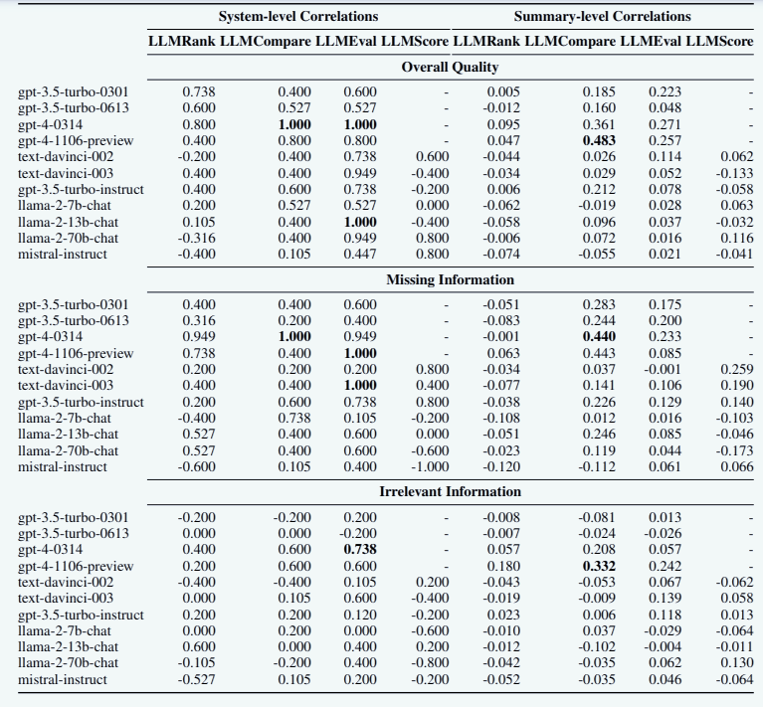
RESULT ANALYSIS
GPT-4 shows a consistent advantage over other LLMs with different evaluation protocols across the three quality aspects.
The effectiveness of evaluation methods is significantly influenced by the choice of protocols. In particular, the pairwise comparison protocol (LLMCompare) consistently outperforms the listwise protocol (LLMRank). Additionally, the most suitable protocol varies for different backbone LLMs.
The effectiveness of evaluation methods is significantly influenced by the choice of protocols. In particular, the pairwise comparison protocol (LLMCompare) consistently outperforms the listwise protocol (LLMRank). Additionally, the most suitable protocol varies for different backbone LLMs.
LLM-based evaluation methods have much higher system-level correlations than summary-level correlations
The LLM-based evaluation methods exhibit varied performance across different evaluation quality aspects. Specifically, evaluating Missing Information proves to be more challenging than assessing Irrelevant Information.
Among all the evaluation methods we evaluated, GPT-4 (gpt-4-0314 and gpt-4-1106-preview) coupled with LLMCompare achieves the strongest performance at system and summary levels.

Slide 13
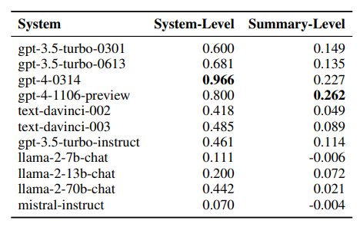
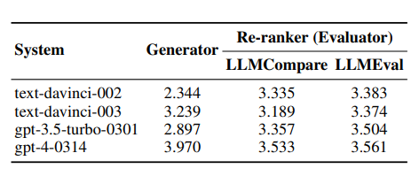
Evaluation Consistency
LLMs exhibit varied behavior and performance when used as generators or evaluators on the same ins-controllable summary task.
The performance consistency of LLMs was evaluated by treating evaluators as re-rankers, comparing their output selection to human-annotated scores.
Results show inconsistencies between generation and evaluation performance, and even advanced models like GPT-4 face challenges in accurately assessing the task as it fails to outperform its generation performance under re-ranking task
A reliable evaluator should be able to give consistent evaluation results even if different evaluation protocols are used.
calculated the correlations of its evaluation results on the LLMCompare and LLMEval protocols.
All the LLMs we evaluated can not achieve a high consistency at the summary level. On the other hand, get-4-0314 can achieve very consistent results at the system level, suggesting that it is the most reliable evaluator.

Slide 14
04
Can We Automate Ins-Controllable Summarization Benchmarking?

Slide 15
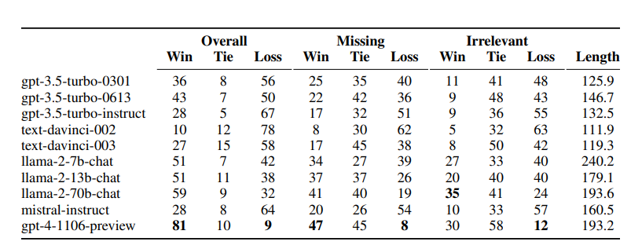
GPT-4 coupled with LLMCompare is chosen for automatic benchmarking due to its superior performance
Evaluation is performed on 11 LLMs using GPT-4 (gpt-4-0314) as a baseline, employing a pairwise comparison setting.
RESULTS
Llama-2 models surprisingly show strong performance under GPT-4's evaluation, even surpassing gpt-4-0314.
Concerns are raised about potential overestimation of Llama-2 models' performance, attributed to
GPT-4 favoring longer summaries.
A case study comparing summaries with similar lengths reveals that, when controlled for length,
none of the LLMs can outperform GPT-4, questioning the robustness of current evaluation methods
for ins-controllable summarization.

Slide 16
REFERENCE:
Benchmarking Generation and Evaluation Capabilities of Large Language Models for Instruction Controllable Summarization
Yixin Liu, Alexander R. Fabbri, Jiawen Chen, Yilun Zhao, Simeng Han, Shafiq Joty, Pengfei Liu, Dragomir Radev, Chien-Sheng Wu, Arman Cohan
https://github.com/yale-nlp/InstruSum/blob/main/README.md

Slide 17
Thanks!

